Slide 1
Facial Expression Recognition
Zhenbang Ju, Jialei Yang

Slide 2
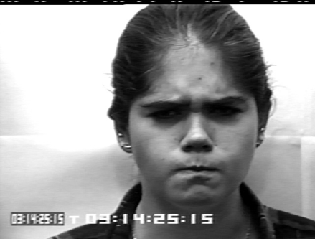
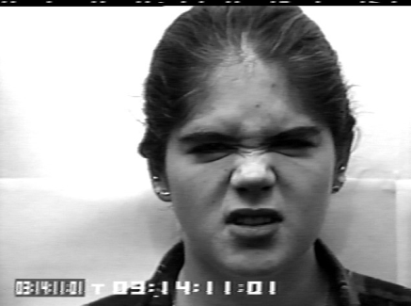
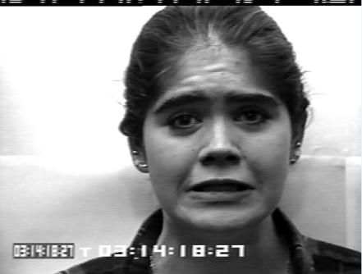
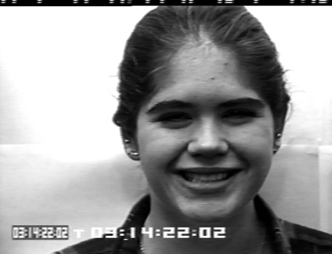
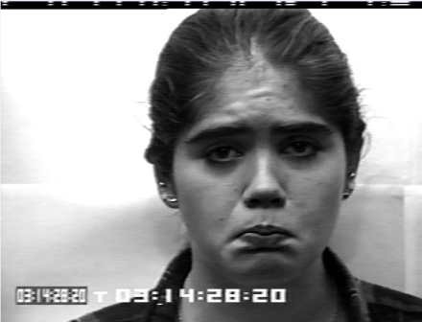
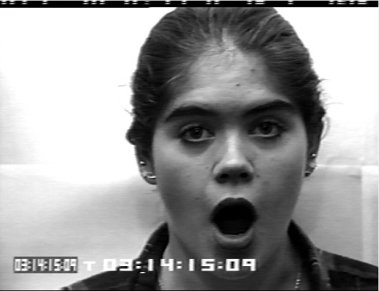
Introduction
Generally, it is thought that, there are 6 basic expressions:
Anger
Disgust
Fear
Happiness
Sadness
Surprise
Database: Cohn-Kanade. http://www.pitt.edu/~emotion/ck-spread.htm

Slide 3
Method
Preprocessing
Feature
Extraction
Classify
Validation
Face Detection
PCA
K-NN
Training: 70%
Testing: 30%
Size Reduction
Gabor

Slide 4
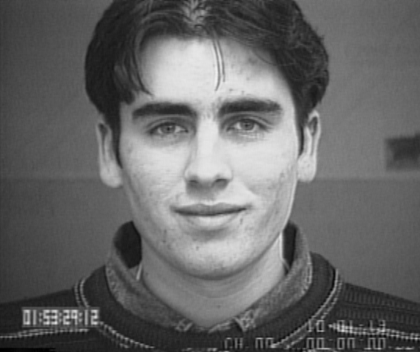
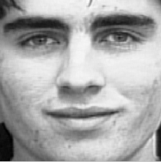
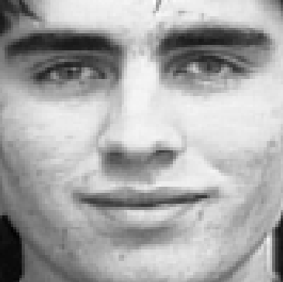
Preprocess
Original
N*N
100*100
Viola-Johns
function
Pixels
Reduction

Slide 5
Feature Extraction: PCA
…
1
2
3
4
1
2
3
4
5
6
7
8
9
5
6
7
8
9
10
11
12
…
Convert a 2-D image (N*N) to a 1-D vector
Component Selected: 90%

Slide 6




Feature Extraction: Gabor Wavelet
2D-Gabor Filter:
8 orientations: u=0, 1, 2 …7
5 scales : v=0, 1, 2 … 4

Slide 7
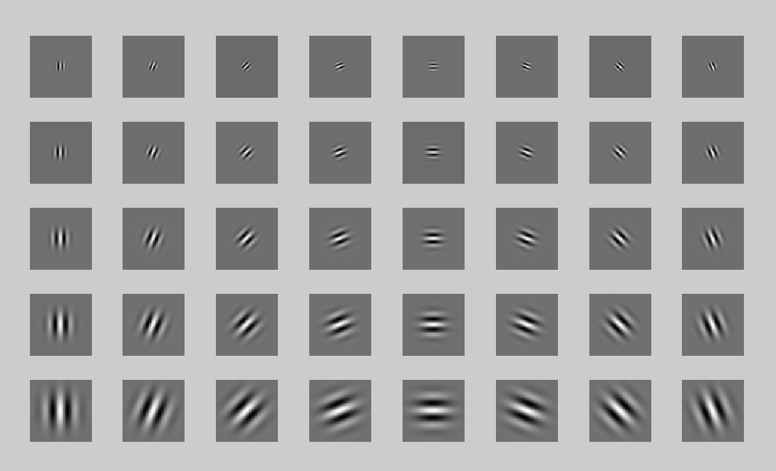
2D-Gabor Filter:

Slide 8
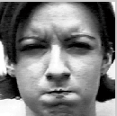
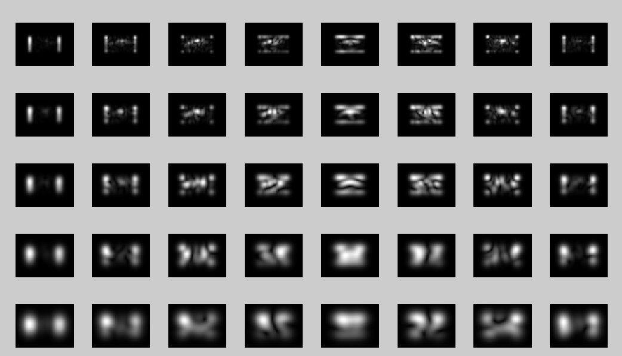

Slide 9

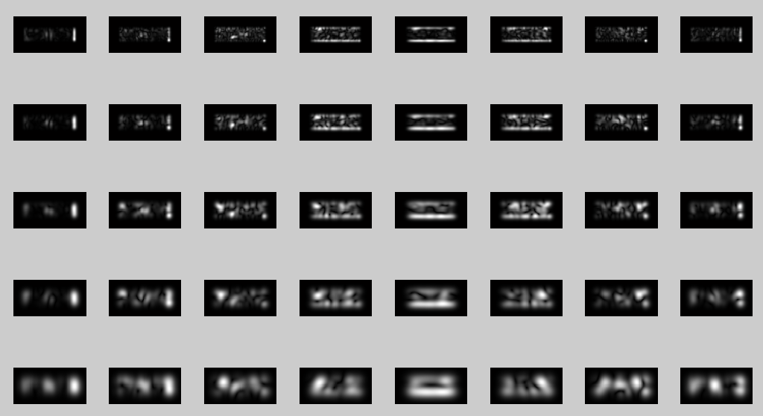

Slide 10
Gabor Features of mouth: 48*64*40
Gabor Features of eyes: 48*96*40
PCA
Gabor Features of mouth: 64
Gabor Features of eyes: 81

Slide 11
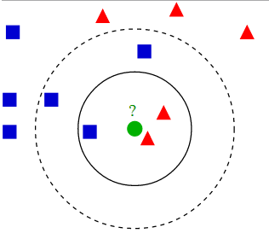
Classification
K-Nearest Neighbor
kn= sqrt(n)
17
Picture from http://en.wikipedia.org/wiki/K-nearest_neighbors_algorithm

Slide 12
Experimental results:
Table 1 Number of each emotions used
 | Anger | Disgust | Fear | Happiness | Sadness | Surprise
Training | 30 | 34 | 41 | 59 | 48 | 51
Testing | 13 | 14 | 18 | 26 | 20 | 22
Table 2 confusion matrix
 | Anger | Disgust | Fear | Happiness | Sadness | Surprise
Anger | 7 | 2 | 0 | 0 | 1 | 0
Disgust | 0 | 9 | 0 | 1 | 0 | 0
Fear | 0 | 0 | 10 | 1 | 0 | 0
Happiness | 0 | 2 | 2 | 23 | 1 | 0
Sadness | 6 | 1 | 4 | 1 | 14 | 2
Surprise | 0 | 0 | 2 | 0 | 4 | 20
Accurate rate: 73.45%

Slide 13
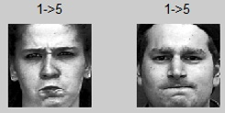
Experimental results:
Anger (classified to sadness)

Slide 14
Conclusion
PCA for global, Gabor for local
Weight of each part of the features
Lack of training samples
Similar expression

Slide 15
Reference
1. Mehrabian, A., 1968. Communication without words. Psychol. Today, 2: 53-56.
2. Ekman, P. and W.V. Friesen, 1978. Facial Action Coding System Action Unit Photographs. 1st Edn., Consulting Psychologist Press. San Francisco, California, pp: 82.
3. Bruce V, 1993. What the human face tells the human mind: some challenges for the robot-human interface. Adv Robot 8(4):341–355
4. Morik K, Brockhausen P, Joachims T, 1900. Combining statistical learning with a knowledge-based approach—a case study in intensive care monitoring. In: 16th international conference on machine
Learning (ICML-99), pp 268–277
5. Senthil R, Valayapalayam K and Venkatesh C, 2012. Facial Expressions Recogni-tion Using Eigenspaces. J. Computer Sci., 8 (10): 1674-1679
6. Wikipedia, http://en.wikipedia.org/wiki/Principal_component_analysis
7. Wikipedia, http://en.wikipedia.org/wiki/K-nearest_neighbors_algorithm
8. Wikipedia, http://en.wikipedia.org/wiki/Gabor_filter

Slide 16
Thank you!

